Slide 1
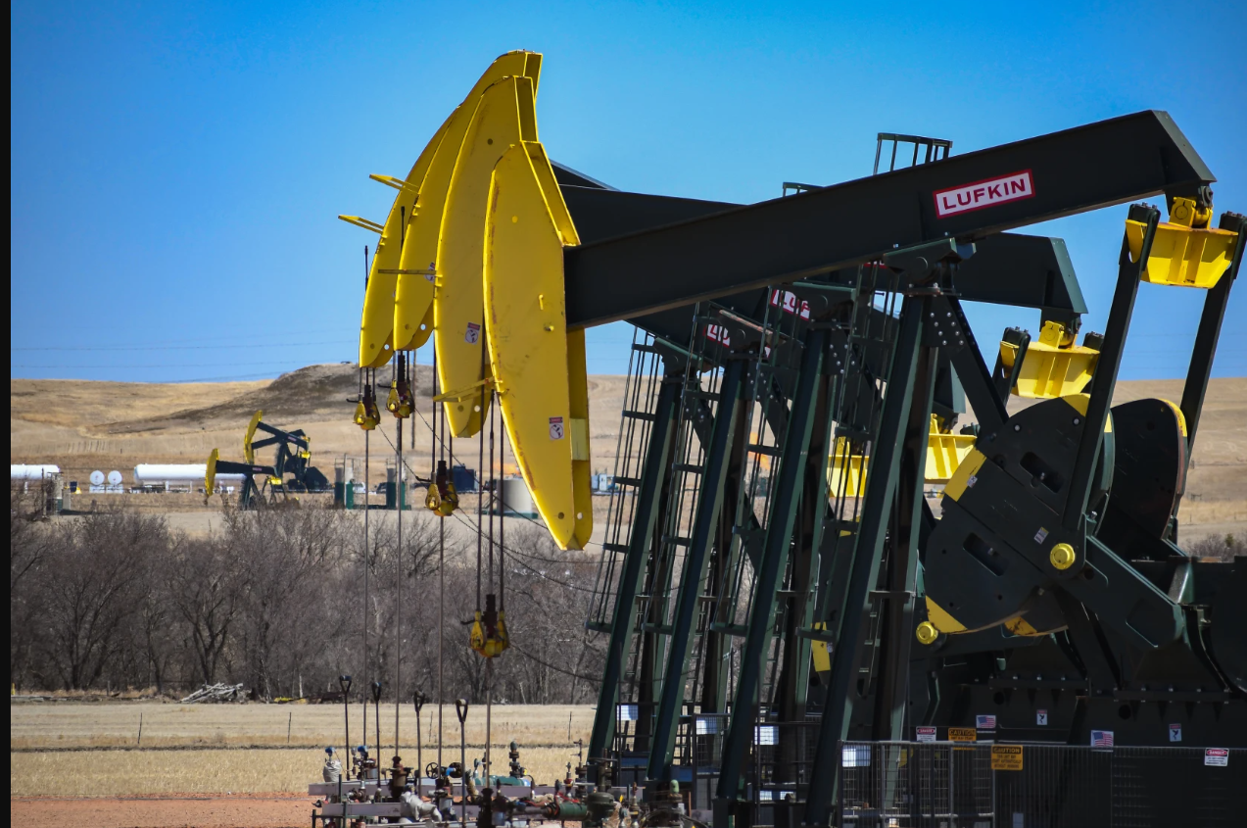

Oil Well Production performance on Volve data set
Abdul Aziz 2215231
Syed Sohaib Ali 2209809
Syed Wajahat Ali 2049216
Shaik Misbah Bilal 2145022

Slide 2
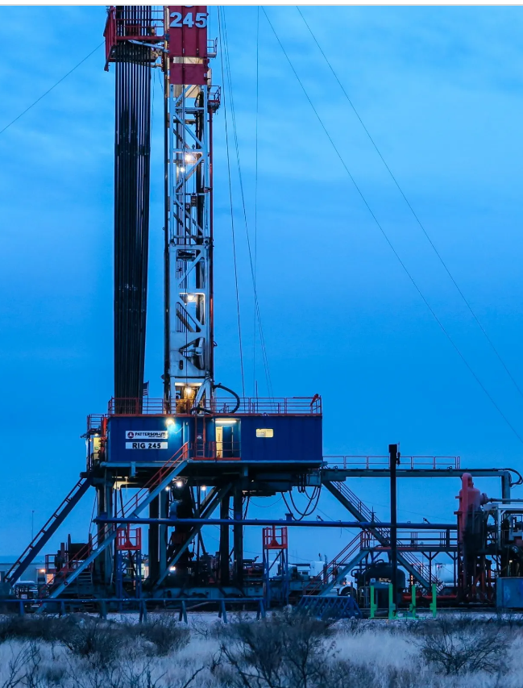
Business Problem
Declining Production
Risk of Well Failure
Lack of Insight
Competitive Pressure
Maintenance and Upkeep

Slide 3
To identify the key factors that affect the production performance of the wells. To identify the wells with significant production and those that are at risk of becoming dry. To learn how the wells differ in their production performance so that we can provide suggestions to enhance the wells' production performance To provide actionable recommendations to improve the production performance of the wells.
Objectives

Slide 4

Increased Production Efficiency Risk Mitigation Compliance Data-Driven Decision Making Innovation
Impact and Values

Slide 5
Predictive maintenance uses data analysis techniques Artificial lift technologies are used to increase the flow of oil from a well including rod pumps, gas lifts, and electric submersible pumps Data Exploration and Analysis Production Performance Modeling Performance Improvement Recommendations
Present Solutions and Our Way

Slide 6
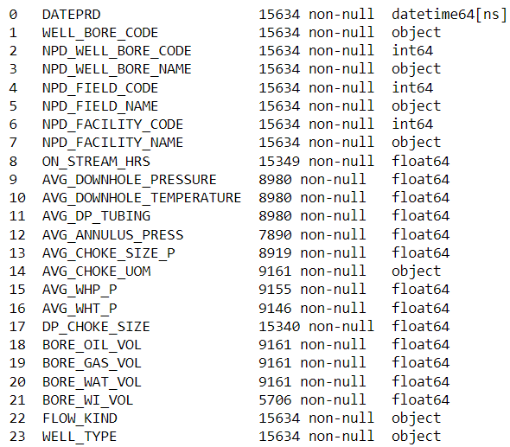

Dataset background and quality
Title | Total Rows | Total Columns
Daily Production Data | 15634 | 24
Monthly Production Data | 527 | 10

Slide 7
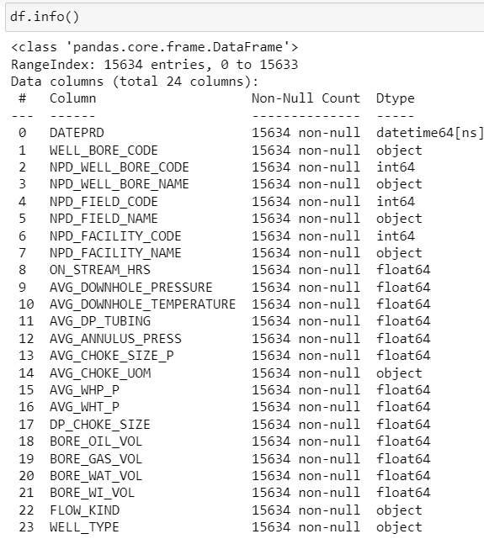
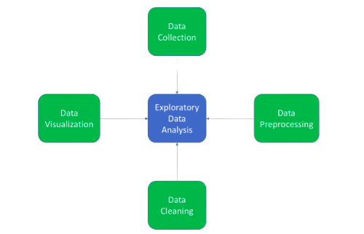
Data Processing and EDA

Slide 8
Methodology
Clustering
Classification
regression
Decision Tree
Random Forest
K-means
Linear Regression

Slide 9
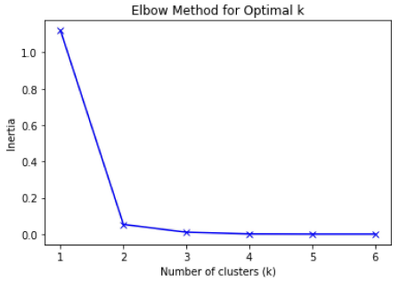
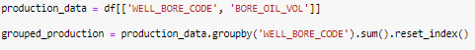
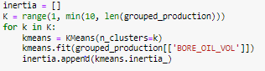
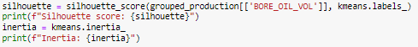
K Means Clustering
Initially, we extract the features that contribute to the production data,
Now, using the elbow method we determine the optimal number of clusters,
As the number of clusters are determined we applied the k-means clustering by utilizing the production data,
Once the model is trained, we determine the silhouette score and Inertia to determine the model performance.

Slide 10
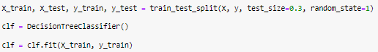
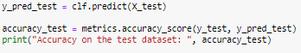
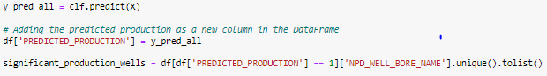
Classification – Decision Tree
Initially we defined a threshold for well that are producing oil significantly which acts as our target variable,
Now, build a decision tree model using the function DecisionTreeClassifier() and fit it with 70% of the training data,
Once the model is trained, we make predictions on the test data to make predictions and determine the accuracy our model,
Now predicting the Significant wells as follows :

Slide 11
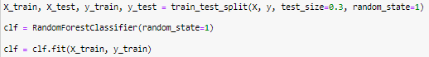
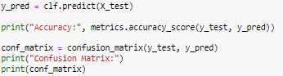
Initially we defined a threshold for well that are producing oil significantly which acts as our target variable,
Classification – Random Forest
To compare the model performances, we also build a random forest machine learning model using the function RandomForestClassifier( ) ,Now fitting the random forest model with the training data,
The accuracy and the confusion matrix is determined as follows
Now predicting the Significant wells as follows :

Slide 12
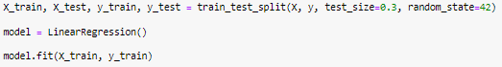
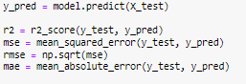
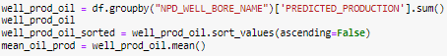
We start build the model by splitting the training and testing data wherein ‘BORE_OIL_VOL’ is our target volume,
Moving further we create a Linear Regression model using the function LinearRegression() which is then fitted on the training data.
Regression – Linear Regression
Then the performance metrics of the model is calculated as follows,
Now the well production can be computed as follows :

Slide 13
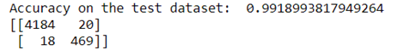
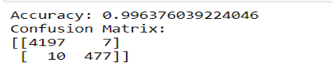
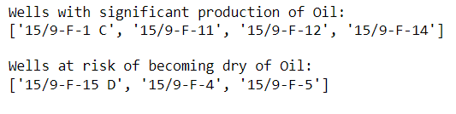
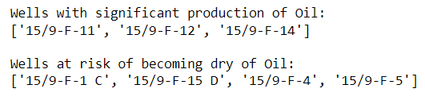
Classification Model: DECISION TREE RANDOM FOREST CLASSIFICATION OF WELLS ON OIL VOLUME: CLASSIFICATION OF WELLS ON OIL VOLUME:
Results and Discussions

Slide 14
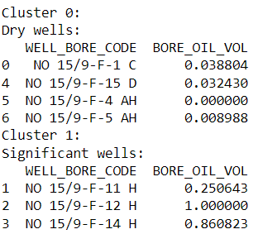
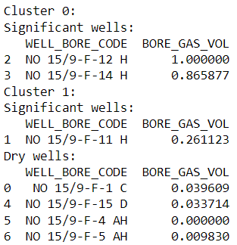
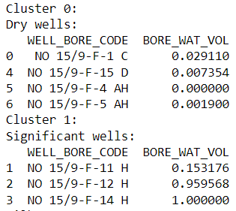
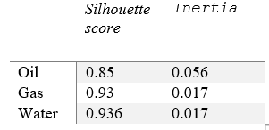
K Means Clustering- Results
ON OIL VOLUME
ON GAS VOLUME
ON WATER VOLUME
TABLE OF METRICS FOR ALL THE K MEANS CLUSTERINGS

Slide 15
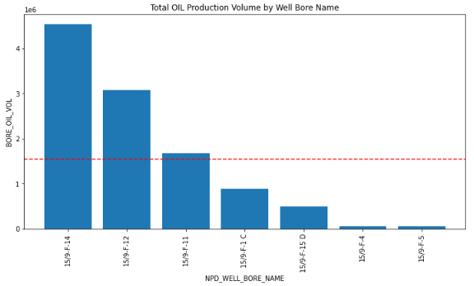
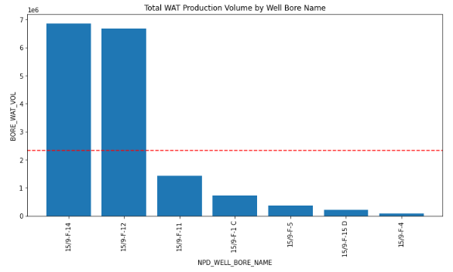
Linear Regression - Results
REGRESSION MODEL ON THE VOLUME OF OIL PRODUCTION
REGRESSION MODEL ON THE VOLUME OF WATER PRODUCTION

Slide 16
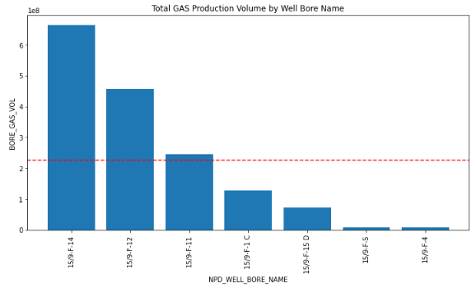
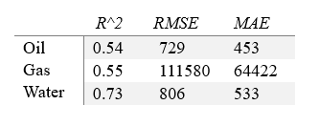
Linear Regression - Results
TABLE OF METRICS OF ALL THE REGRESSION MODELS USED
REGRESSION MODEL ON THE VOLUME OF GAS PRODUCTION

Slide 17
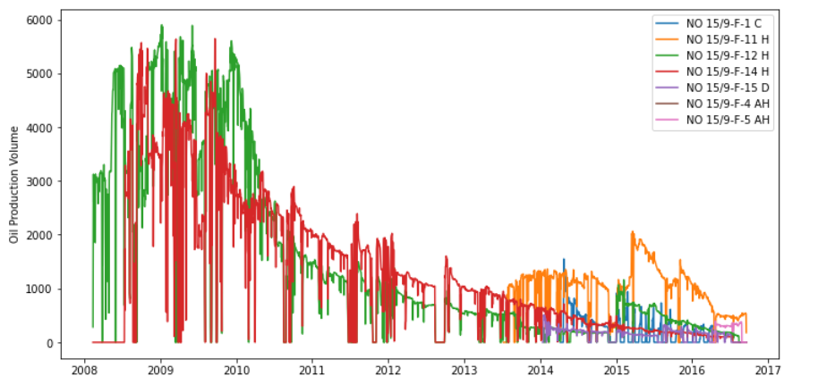
Production of wells over the years

Slide 18
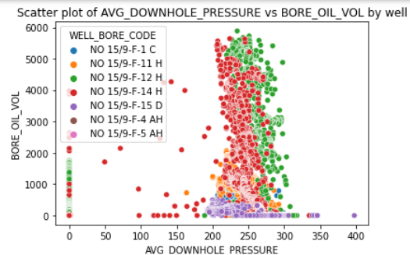
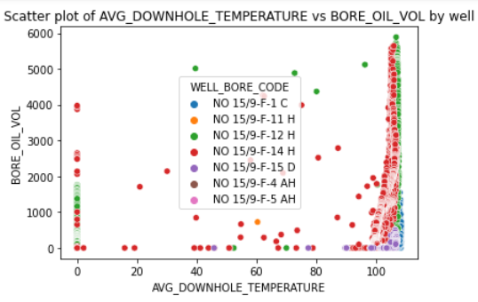
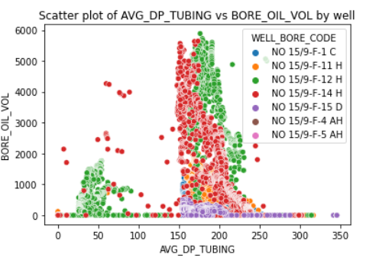
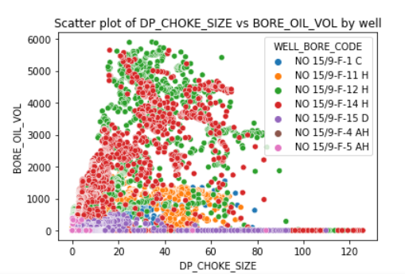
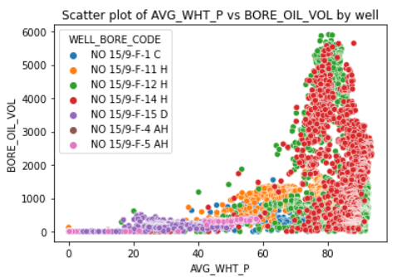
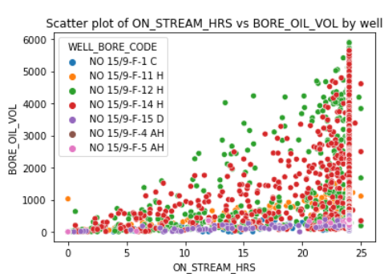
Factors affecting the performance of wells

Slide 19
Gas production optimization could boost the wells oil production From the models the significant wells are NO15/9-F-12 , NO15/9-F-14, NO15/9-F-11 which can also be cross validated with the visualization's above around the optimal conditions that these wells will not be dried-up Recommendations would be to use the optimal conditions as like choke size range, temperature range, downhole pressure range at which the well is giving the high oil volume Continuous data analysis will help is better decision-making process and better oil production
Conclusions and Recommendation

